Slide 1

StackOverflow Developer Survey 2019
Presented by: Bach Tran
Date: 15/07/2025
LinkedIn: https://www.linkedin.com/in/xuanbach/

Slide 2



OUTLINE
Executive Summary
Introduction
Methodology
Results
Visualization – Charts
Dashboard
Discussion
Findings & Implications
Conclusion
Appendix

Slide 3

EXECUTIVE SUMMARY
Data contextualization and analysis objectives
Methodology description
Data gathering
Data analysis
Data visualisations
Results presentation supported with graphs and trends.
Discussion of overall findings and implications regarding the results previously exposed.
Final conclusions of the carried out research.

Slide 4

INTRODUCTION
Stack Overflow’s annual Developer Survey is the largest and most comprehensive survey of people who code around the world.
Results don’t represent everyone in the developer community evenly.
Nearly 90,000 developers.

Slide 5

METHODOLOGY
Collect survey data & explore its content
Web Scraping
APIs.
Request library.
Data Wrangling
Exploratory data analysis
Analyzing data distribution.
Handling outliers.
Correlations.
Data Visualization
Highlight distribution of data, relationships, the composition and comparison of data.
Dashboards

Slide 6
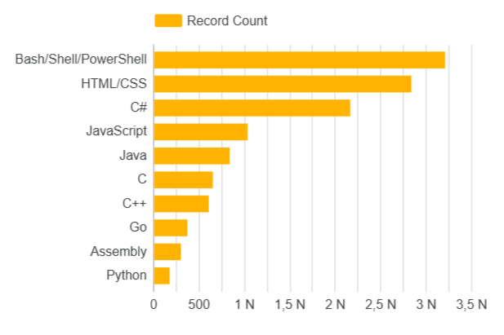
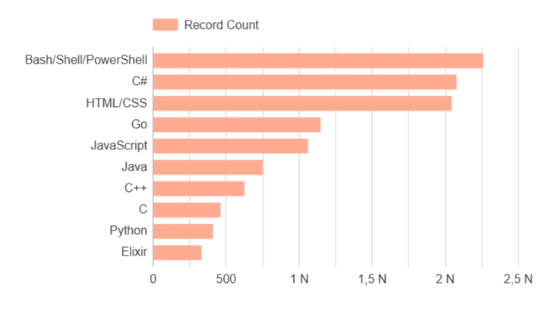
PROGRAMMING LANGUAGE TRENDS
Current Year
Next Year

Slide 7
PROGRAMMING LANGUAGE TRENDS - FINDINGS & IMPLICATIONS
Findings
Bash/Powershell seems to be the most widely used language
Followed by HTML/CSS
Noticeably, Assembly is out of the predicted top most used language in next year
Implications
Potential rise of languages used for web design and development.

Slide 8
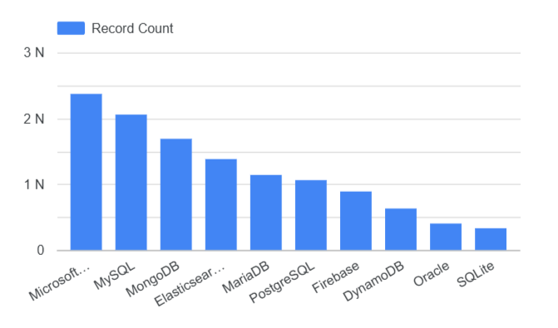
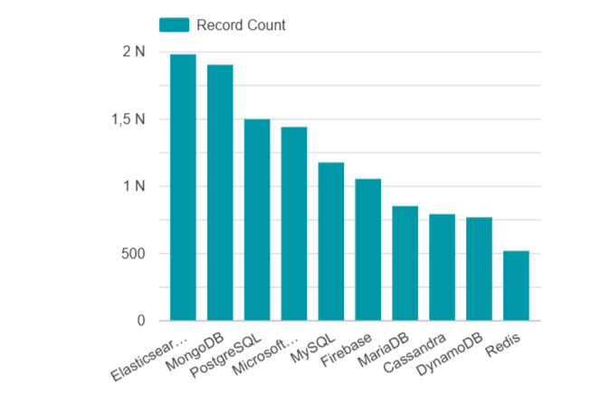
DATABASE TRENDS
Current Year
Next Year

Slide 9
DATABASE TRENDS - FINDINGS & IMPLICATIONS
Findings
Microsoft SQL Server was the most widely used in 2019
Most of the database are SQL-based in 2019
Unexpected rise of Elasticsearch amongst the SQL DB
Implications
Potential rise of a new competitor
Microsoft SQL Server is losing its competitive edge to others.

Slide 10

DASHBOARD

Slide 11
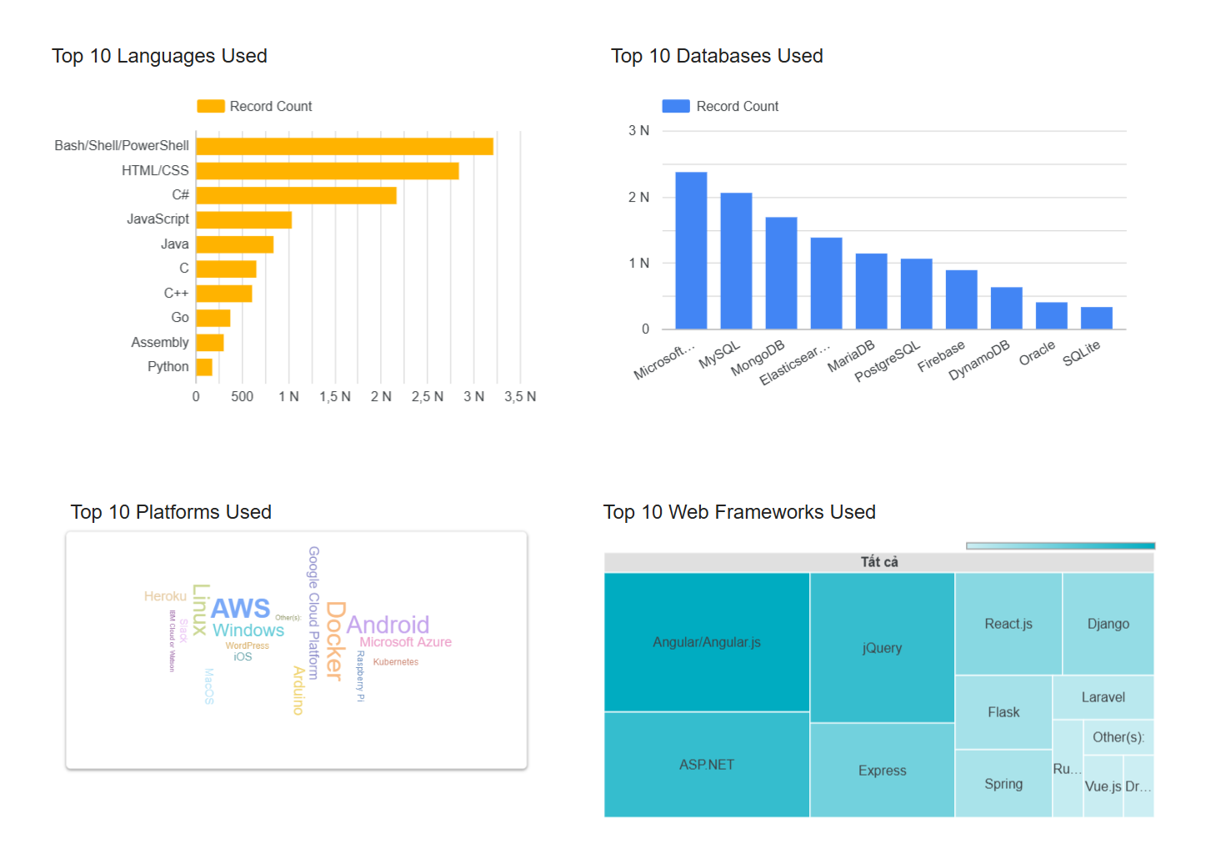
Current Technology Trend

Slide 12
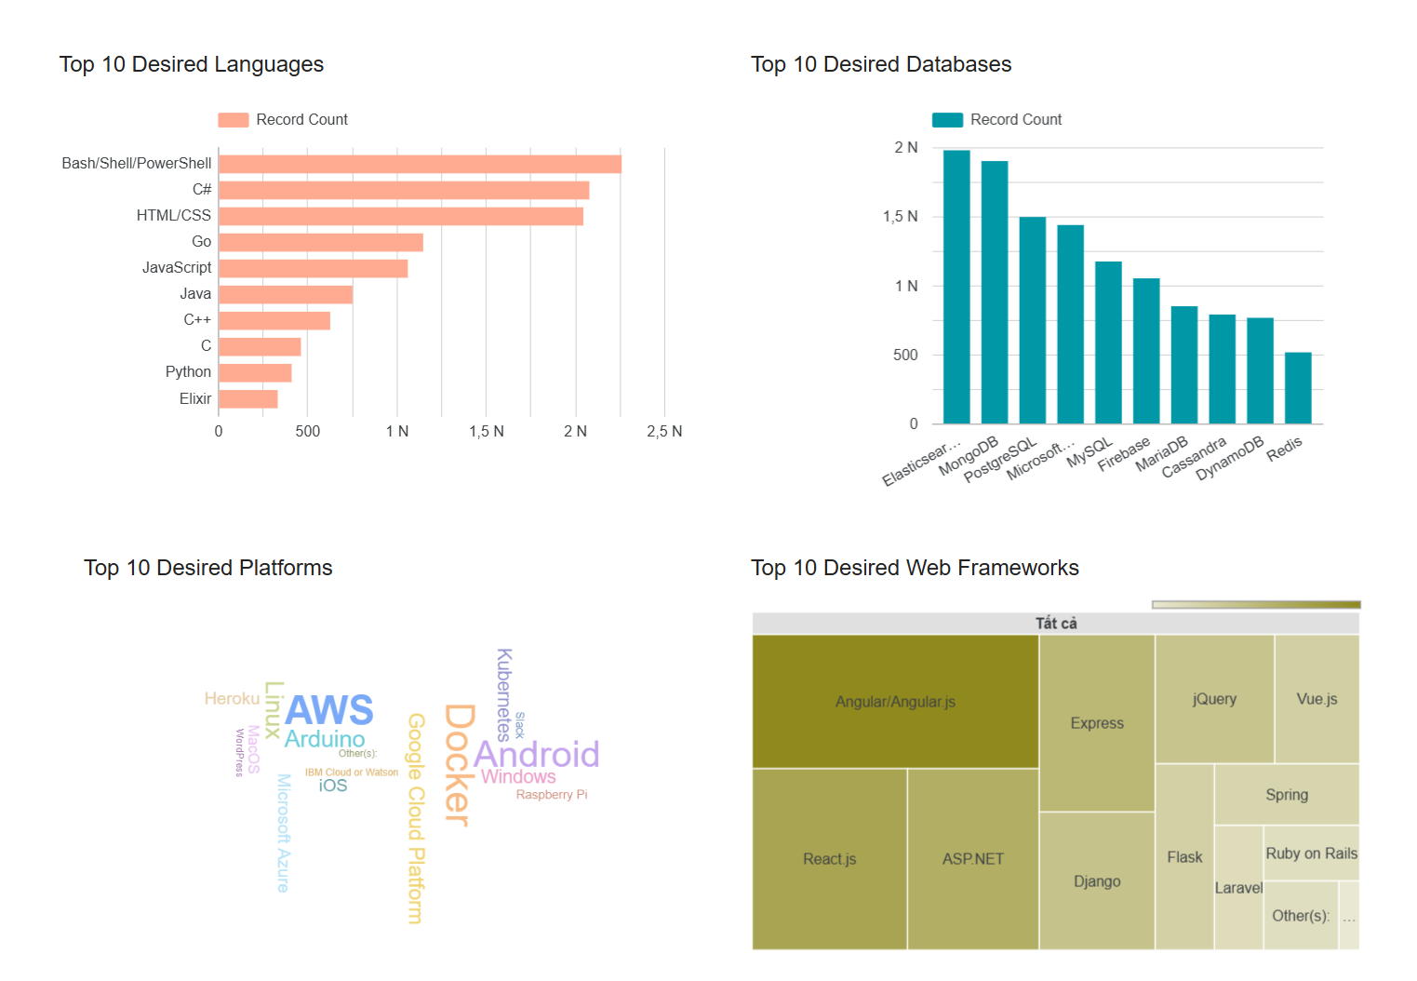
Desired Techology Trend

Slide 13
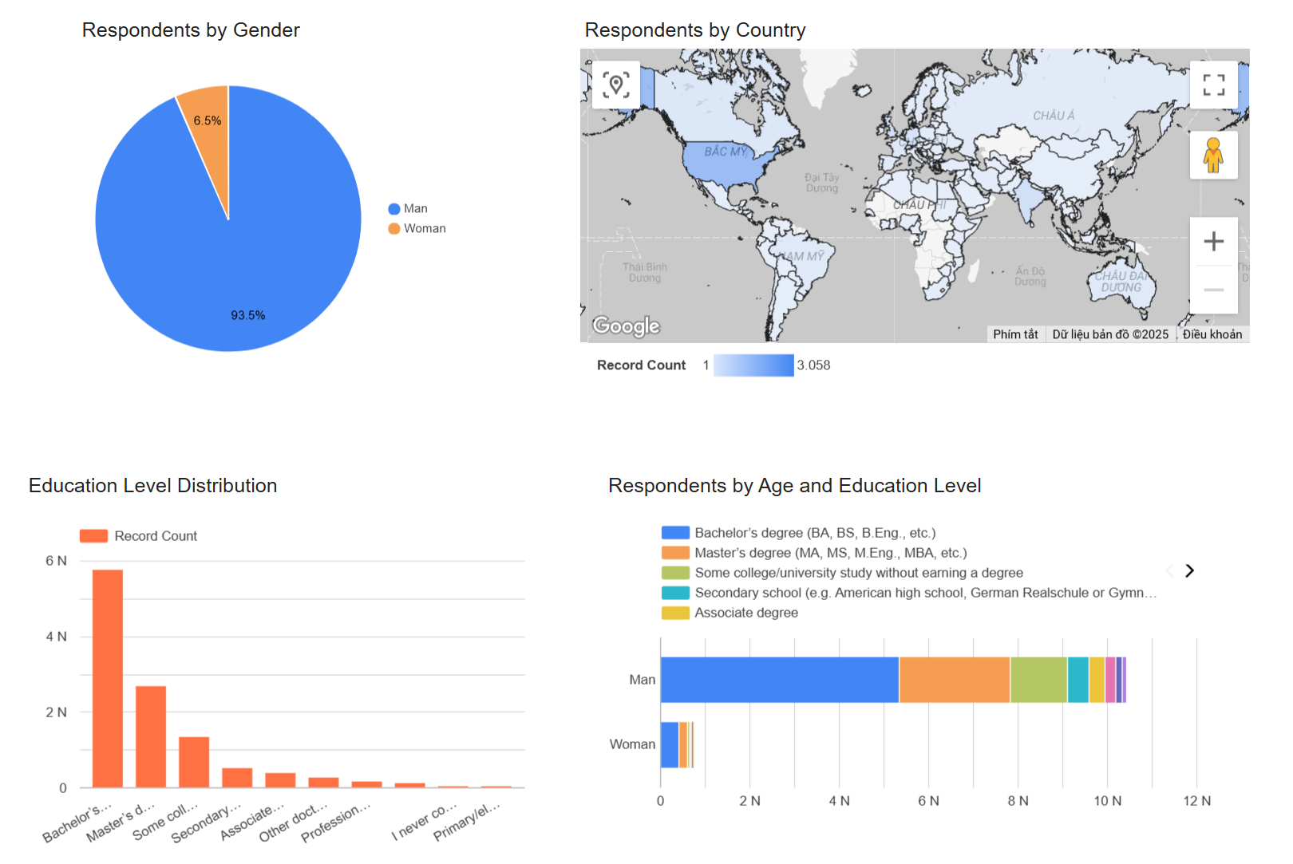
DASHBOARD TAB 3

Slide 14
DISCUSSION

Slide 15
OVERALL FINDINGS & IMPLICATIONS
Findings
Some of the most widely used platforms are AWS, Docker, Android…
More than 90% of the respondents are Male
USA has the most number of respondents
Implications
AWS, Docker, Android are gaining popularity
Major gap in IT as profession for both genders
Most developers are from the USA, which is evident as StackOverflow itself was created in the country.

Slide 16

CONCLUSION
The dashboard visualized the most important components of tech
There are still some bias such as the large gender gap of respondents
Overall, there is a need to spread accessibility of this labor market to countries in development.

Slide 17

APPENDIX

Slide 18
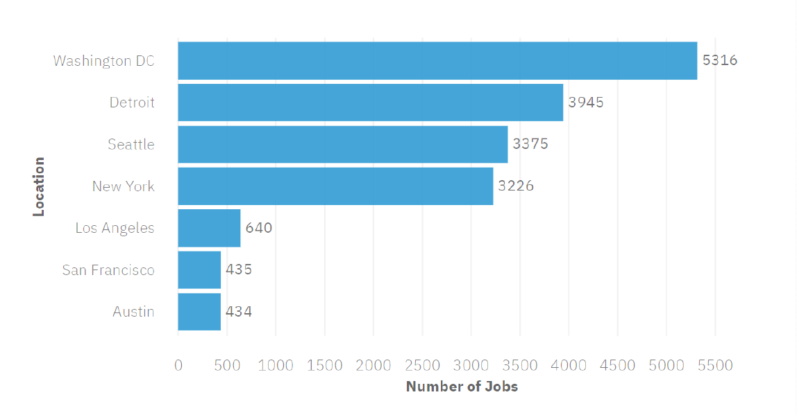
JOB POSTINGS

Slide 19
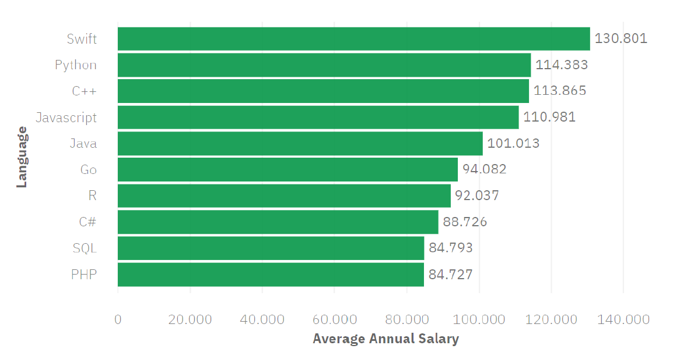
POPULAR LANGUAGES

